Slide 1
Capstone Project: Comparing Neighborhoods in Washington, DC
Alexander Hay October 2020

Slide 2
Introduction
In the early 2000s, the Office of Planning divided the city into 39 "reasonably descriptive units of the city," or "clusters.”
Since their creation, these cluster boundaries have been maintained by city officials and have allowed for the comparison of different regions of the city.

Slide 3
Business problem
It would be useful for city officials to group these clusters based on their characteristics.
This would allow officials to identify inequities between the clusters, and allocate resources to different parts of the city more efficiently.
Additionally, it would be useful for real estate developers to understand which neighborhood characteristics have the greatest effect on housing prices.

Slide 4
3 main goals
To "cluster" these neighborhood clusters based on their number of restaurants, and on their crime, income, employment, population, and housing data.
To identify the features (number of restaurants, crime, income, employment, population) that are most correlated with housing prices.
To create a model, based on those features, that predicts housing prices.

Slide 5
Data
To gather location data for the neighborhood clusters, I used Open Data DC.
The geojson file included the shape and area of all 39 clusters.
To gather demographic data for the neighborhood clusters, I used data from Urban-Greater DC.
The various csv files included information about crime, income, employment, population, and housing for all 39 clusters.
To gather nearby venue data in each of the clusters, I used the Foursquare API.
After I found the centroid of all the neighborhood clusters, I searched Foursquare to find restaurants within 250 meters of that point.

Slide 6
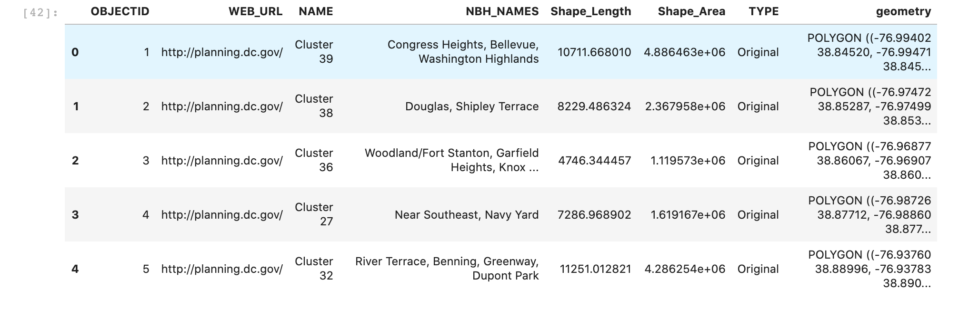
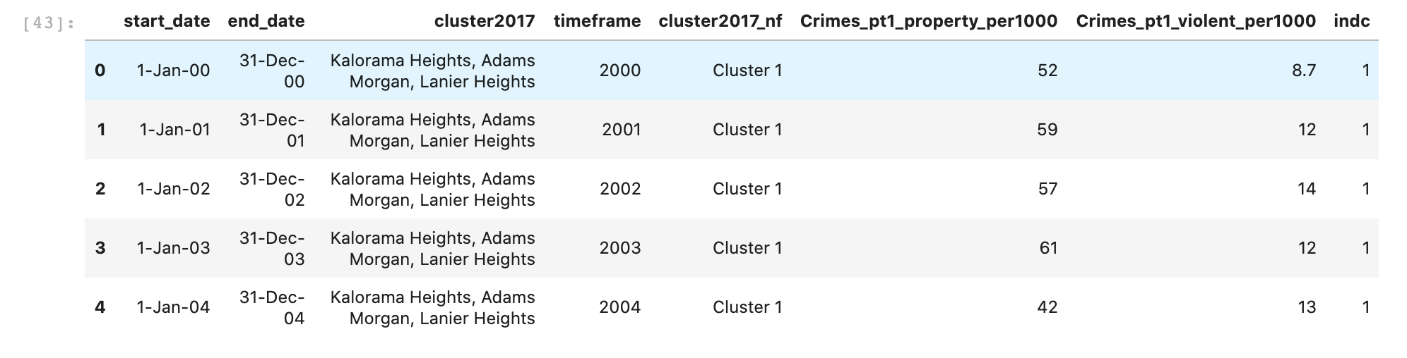
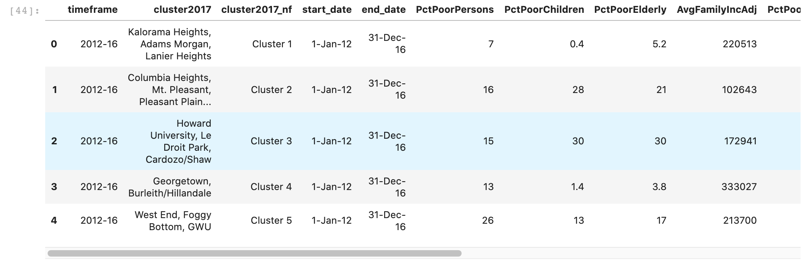
Geography:
Crime:
Income:

Slide 7
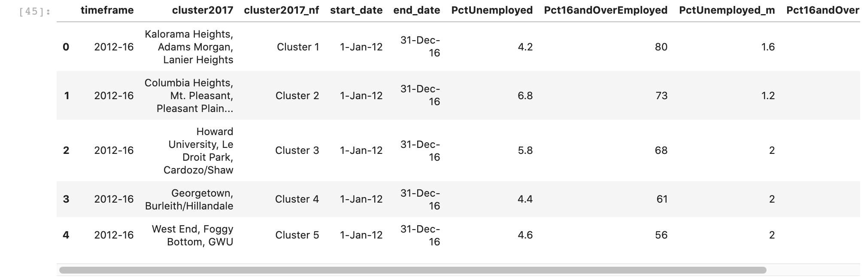
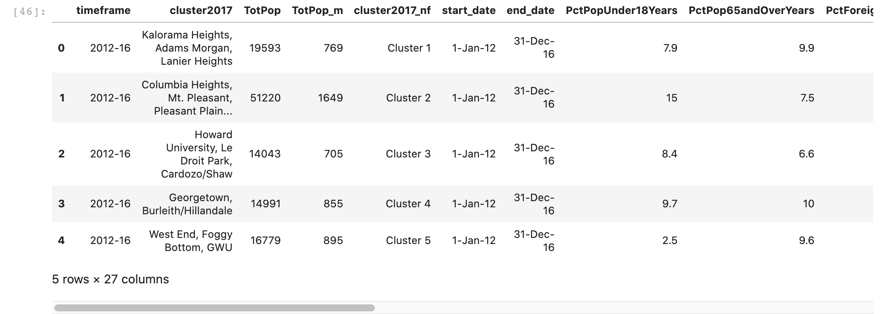
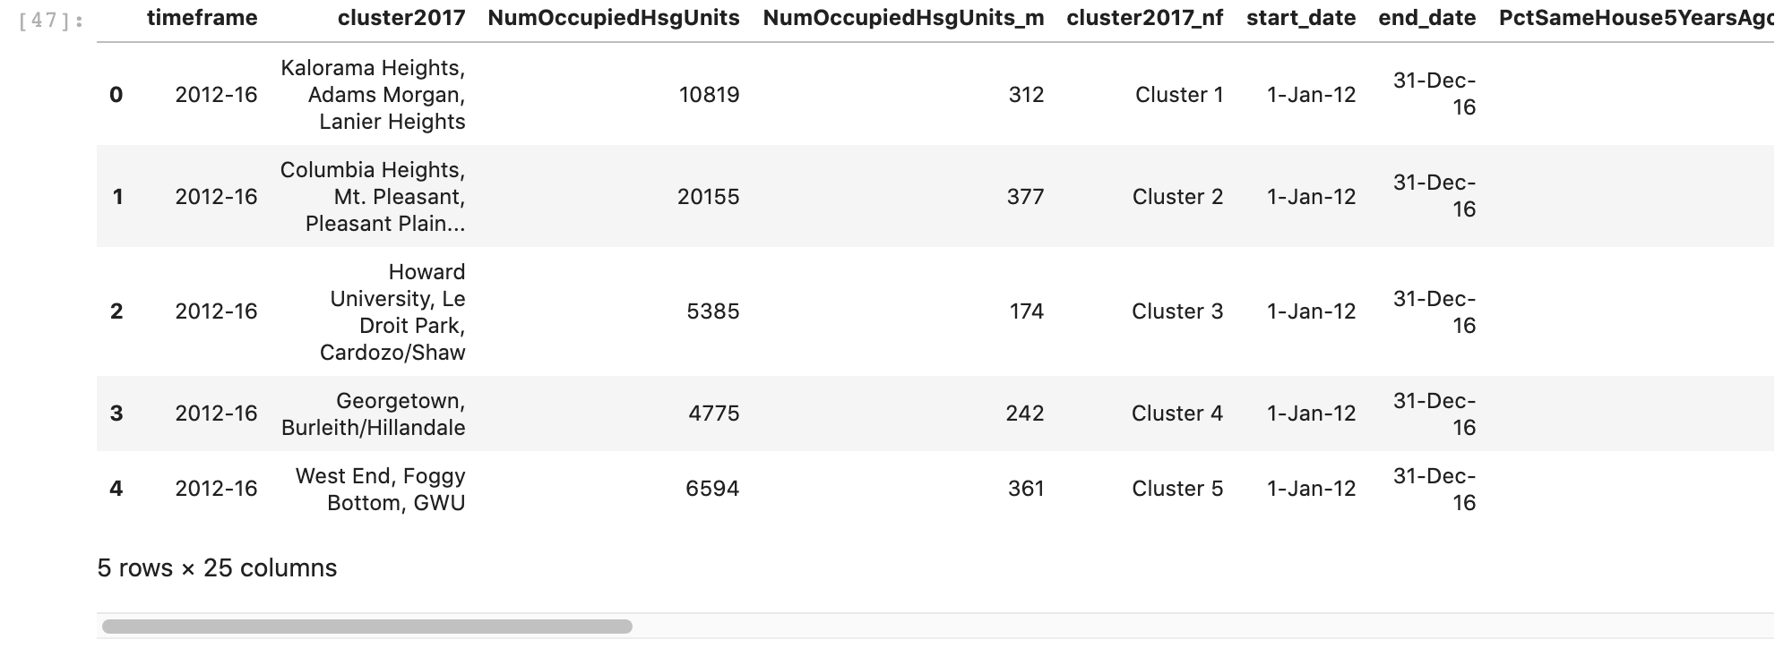
Employment:
Population:
Housing:

Slide 8
Goal 1: ”Cluster” DC Neighborhood clusters

Slide 9
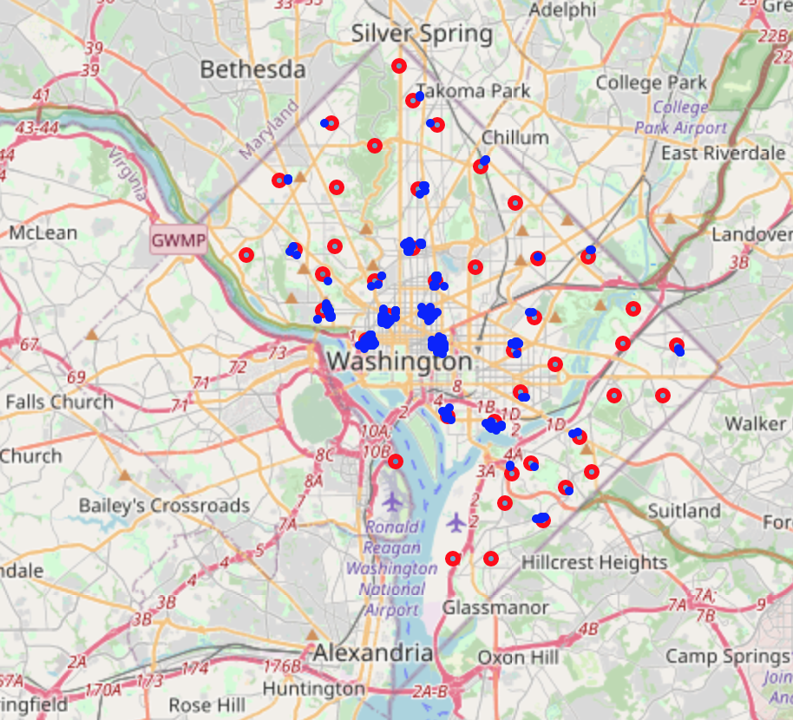
Methodology
Found the centroid of all the neighborhood clusters, then searched Foursquare to find restaurants within 250 meters of that point. Below is a map showing the restaurants in each cluster.

Slide 10
Methodology
Feature extraction- I read in all the demographic data and extracted the following features: property crimes per 1000 residents, violent crimes per 1000 residents, average family income, percentage unemployed, total population, and median sales price of a single family home.
I merged this data with the restaurant data to get the full dataset.
Normalized the data using the sklearn.preprocessing.scale() function
Clustered the neighborhood clusters using the KMeans algorithm, an unsupervised machine learning technique.

Slide 11
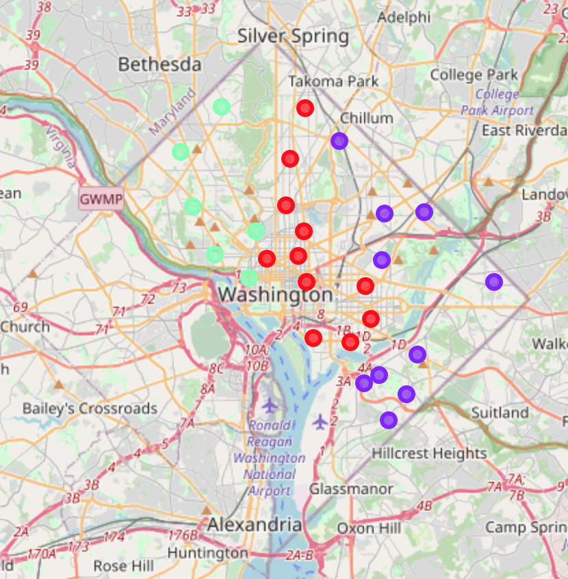
Cluster map
Used Kmeans algorithm to “cluster” neighborhood clusters

Slide 12
Examining clusters
The first group (red) had more varied features than the others, but generally these neighborhood clusters had lots of venues, a low unemployment rate, and a high population.
The neighborhood clusters in the second group (purple) typically had low average income, a high unemployment rate, and low housing prices.
The neighborhood clusters in the third group (green) typically had a low crime rate, a high average income, a low unemployment rate, and high housing prices.

Slide 13
Discussion
The KMeans algorithm clustered the neighborhood clusters nicely; there was a clear geographic separation between the groups. The groupings made sense, as western DC consists of wealthy areas such as Georgetown, Adam's Morgan, and Friendship Heights. Central DC is considered "downtown", and consists of areas such as Dupont Circle, Columbia Heights, Chinatown, and Capitol Hill. Eastern DC consists of poor areas such as Fort Totten, Ivy City, and Anacostia. These clusters reinforce what DC officials already know about the city, but nevertheless it is useful to visualize these boundaries on a map. In the future, I would like to form clusters based on more features, and do a more thorough manipulation of the number of KMeans clusters.

Slide 14
Goal 2: Find which features are most correlated with housing prices

Slide 15
Methodology
Split the data into the features and labels.
The features consisted of property crimes per 1000 residents, violent crimes per 1000 residents, average family income, percentage unemployed, and total population.
The labels were the median sales price of a single family home.

Slide 16
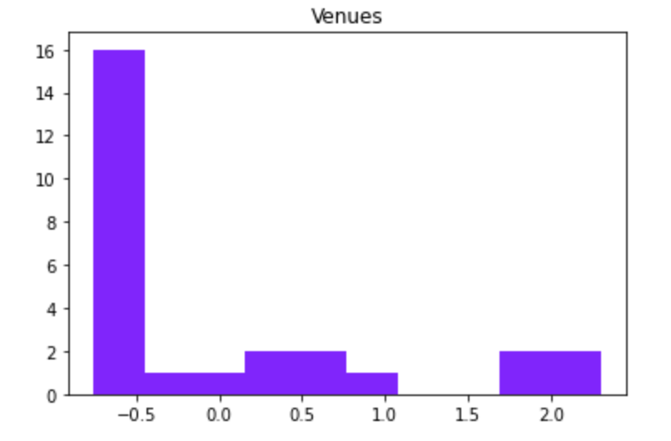
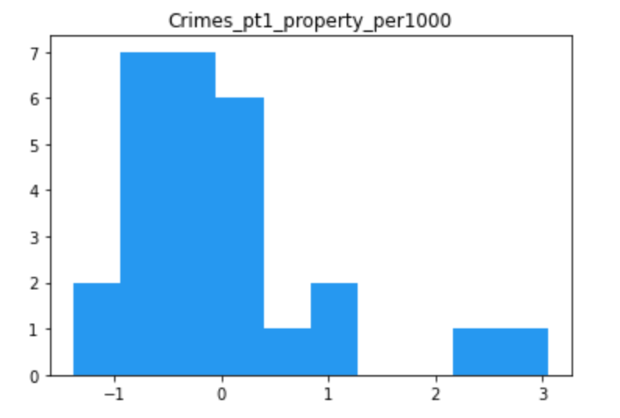
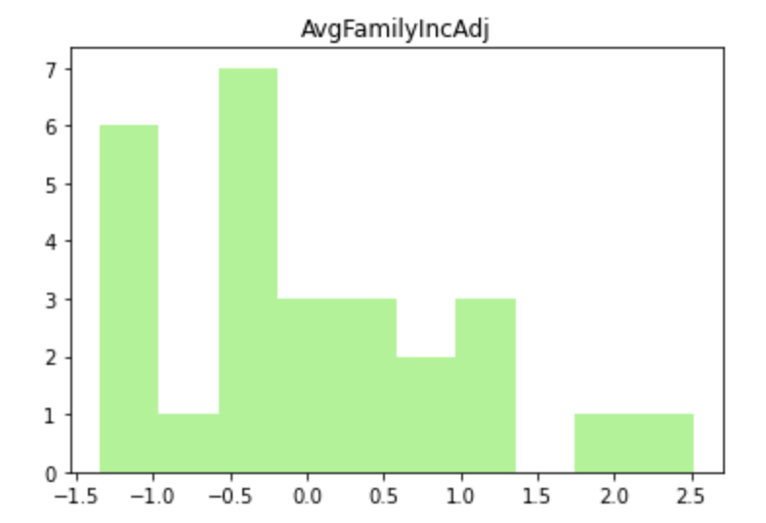
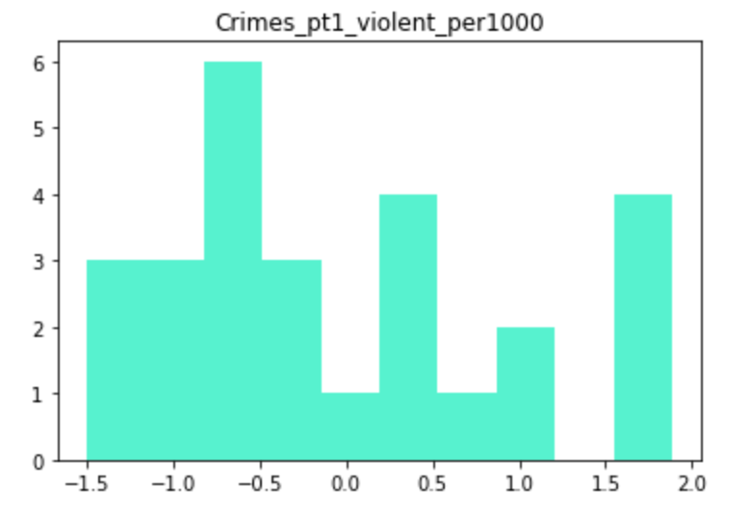
Examine distribution of features & labels

Slide 17
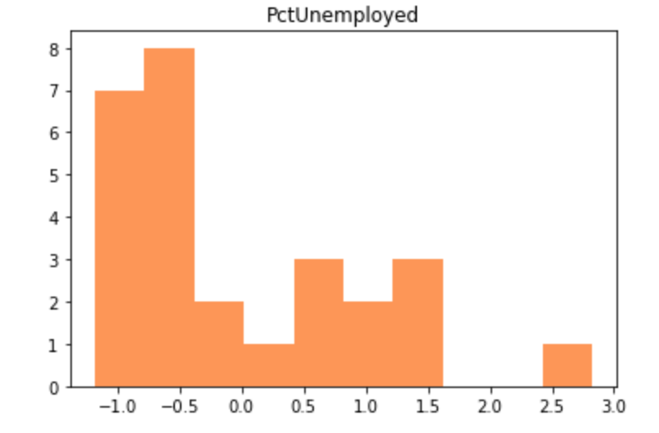
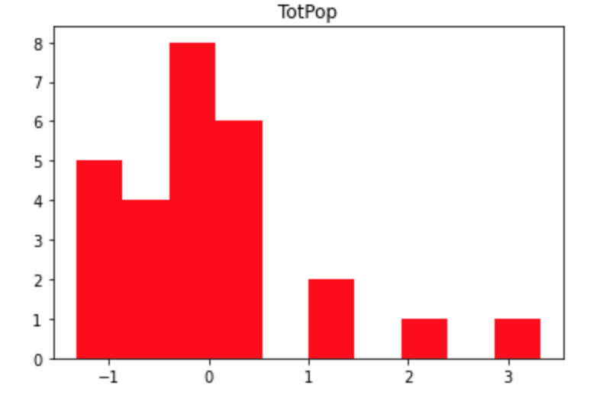
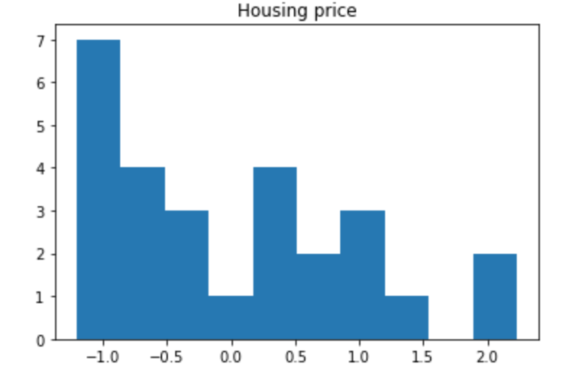
Examine distribution of features & labels
Most features were not normally distributed, and neither were the labels. This could have affected the results.

Slide 18
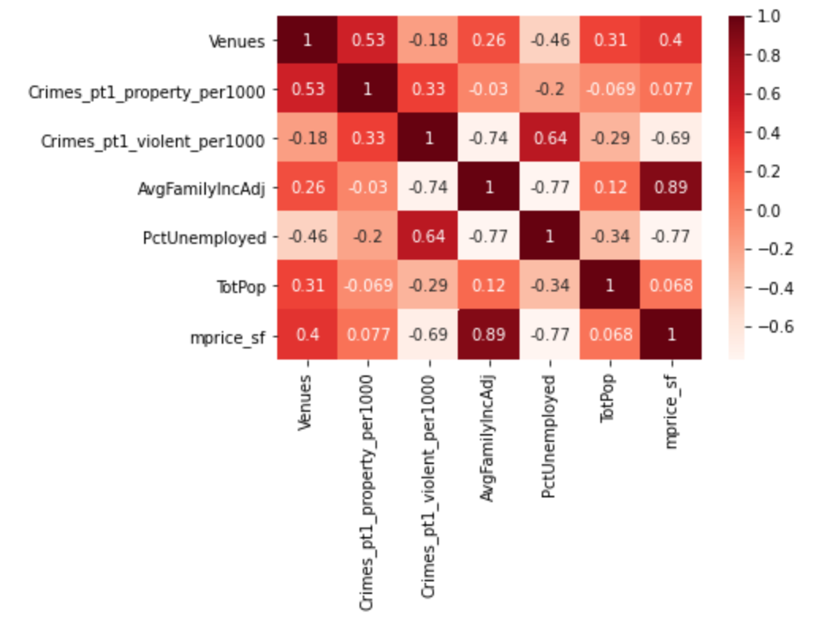
Correlation Matrix
Shows the Pearson Correlation Coefficient for each two-variable relationship

Slide 19
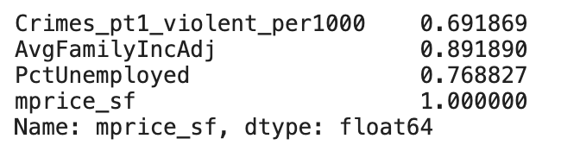
Correlated with housing price
It appeared that the unemployment rate, average family income, and violent crimes per 1000 residents were most correlated with the housing prices.

Slide 20
Discussion
Unsuprisingly, I found that the unemployment rate, average family income, and violent crimes per 1000 residents were most correlated with the housing prices. It makes sense that housing prices are high where there is a low unemployment rate, a low crime rate, and a high average income. This is a well-established phenomenon in many cities, but nonetheless it is useful for real estate developers to know that DC is no exception. Additionally, the relationship between number of restaurants and housing prices was modest, as it had a Pearson's Correlation coefficient of 0.4. Perhaps the relationship is only modest because I did not specify the type of restaurant. I suspect that if I limited the criteria to only expensive restaurants, there would be a stronger correlation with housing prices. In the future, I would like to see how other features, such as average school rating, are correlated with housing prices.

Slide 21
Goal 3: Create model to predict housing prices

Slide 22
Methodology
70/30 train test split
Linear regression
Random forest regression
Gradient boosting regression
Evaluated with mean squared error

Slide 23
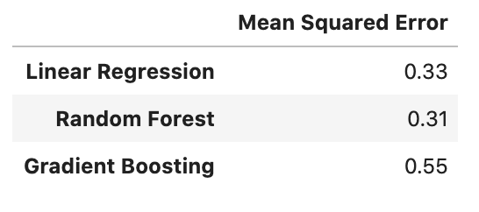
Results
None of the models performed especially well, but the linear regression and random forest models both performed much better than the gradient boosting model.
Overall, the random forest model performed the best.

Slide 24
Discussion
None of the models performed especially well, but the linear regression and random forest models both predicted housing prices better than the gradient boosting model. Perhaps if I tuned the hyperparameters of the gradient boosting model it would have performed better. Overall, I think the models performed poorly because there were not enough observations. A 70/30 split gives only 19 observations in the training set and 8 observations in the test set. In the future, I would like to add more observations, and potentially more features, to boost the performance of these models. Additionally, I would like to apply more complicated models, such as neural networks.

Slide 25
Conclusion

Slide 26
3 main findings
Using the number of restaurants, property crimes per 1000 residents, violent crimes per 1000 residents, average family income, percentage unemployed, total population, and median sales price of a single family home, the KMeans clustering algorithm produced 3 groups of DC neighborhood clusters. The city was effectively divided into the west side, downtown, and east side.
The variables most correlated with housing prices were the unemployment rate, average family income, and violent crimes per 1000 residents. Housing prices were only modestly correlated with the number of restaurants.
Using the number of restaurants, property crimes per 1000 residents, violent crimes per 1000 residents, average family income, percentage unemployed, and total population, the random forest regressor best predicted the median sales price of a single family home. The linear regressor performed similarly, and the gradient boosting regressor performed the worst. However, none of the models performed especially well, and more observations are needed to create a better model.

Slide 27
Sources
Open Data DC: Geojson data
Demographic data: Greater DC public data
Foursquare API data: Nearby venues
Sklearn documentation
Dependencies: See requirements.txt

